Slide 1

‘Under Construction’ Booking System
Jack Browne

Slide 2

What is ‘Under Construction?’
Under Construction is a company that owns 2 musician’s practice rooms in central Cathays.
The practice rooms are hosted by the Cathays & Central Youth & Community Project (CCYCP).
These rooms are possibly the most popular band/solo musician practice locations in Cardiff due to the low prices and appropriate equipment set-up.
The practice rooms can be hired for a number of hours by any number of people, of any age, at any time – however each of these factors will influence the price.
The venue also offers gig hosting and studio recording.

Slide 3
Why Does ‘Under Construction’ Need A New System?
At the moment, the booking system in place is very primitive. The secretary takes booking requests by email, then writes down the booking details. In my own experience, I have had to cancel a paid gig due to a double booking as well as having to negotiate the price after each practice session due to frequent staff rotations.
A booking system would fix these issues – the program will automatically prevent double bookings and will determine a price that the artists have to pay. This will clear up any confusion that staff may have about the highly volatile fees.
I also believe that the increase in efficiency will help improve the CCYCP in general, as they host many events and having the booking system automated will leave the staff with much more time on their hands.

Slide 4
Functionality For The Customers.
The system should:
Allow artists to register themselves or their band to be kept on the system.
Artists should be able to delete only their own details from the system (this will purge the system of this user’s data).
Allow artists to request a booking that suits them.
Show artists an error message if the time or additional equipment they have chosen is already occupied.
Calculate and display the total cost of the booking based on the tariff and any additional equipment requested.
Send the artist a confirmation email once the booking has been confirmed.

Slide 5

Functionality For The Employees
The employees should receive a weekly email report that is generated by the system detailing a log of who booked when as well as money taken in (possibly with extra info such as peak times).
Employees should be able to cancel and amend bookings.
Employees should be able to add new login details for other new employees.
Employees should be able to update equipment hire information (e.g. if something breaks, remove it from the system).

Slide 6

Underlying Functionality
The system will handle all of the dates and times of booking internally and store a virtual calendar in its memory – this will be used to prevent double bookings.
Contains pre-set data about the booking system so that someone doesn’t book a time which outside of working hours or books a room which doesn’t exist.
Masking will be used in order to increase security of the system and prevent accounts from being hacked into.
A stock system will be used to give availability information about equipment hire.

Slide 7
Requirements To Run The System
The CCYCP will need at least one computer with Microsoft Access installed in order to run the system.
A web server will also be required in order to publish the database and form so that it can be accessed by the customer.
Someone with an intermediate level of ICT knowledge to use and maintain the system as well as answering user queries. This may require training.

Slide 8

Limitations To The System
The system is very likely to have bugs, therefore an expert may be required if something breaks, which will be costly.
Training may be required to use the system, however it is designed to be as intuitive as possible.
The system cannot handle every aspect of the business, such as employee payroll.

Slide 9
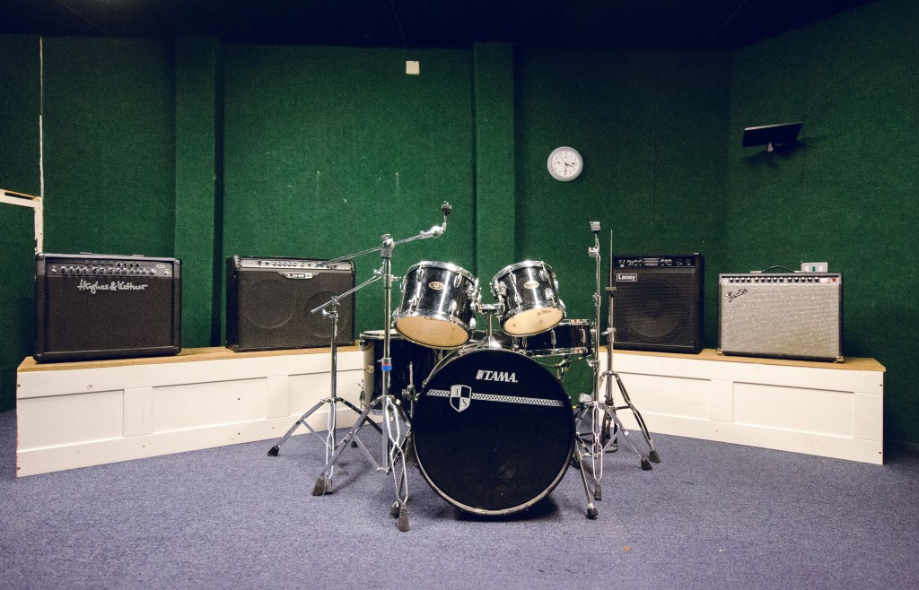
Feedback
Thank you for watching, any questions or feedback in the form of criticisms or improvement ideas are welcomed.

